Slide 1
C++ No-SQL Database Web Framework
for Cloud-based Websites

Slide 2
Purpose of Web Framework
Websites need database data storage and retrieval
Increase developer productivity
Provide built-in code to handle tasks
Shortens time to create a web application
Enforce specific coding patterns
Simplifies network and database access
Allows consistency and understandability
Increases maintainability

Slide 3
Why use this framework
Written in C++ and uses a No-SQL database
Faster than interpreted languages or RDMS
Increases user responsiveness
Reduces cloud server CPU and storage costs
Simpler to program
Fewer components for developers to manage
More convenient system administration
Easier to deploy to the cloud

Slide 4
Other C++ Web Frameworks
Oat++ (oatpp.io)
Drogon (drogon.org)
POCO (pocoproject.org)
TreeFrog (www.treefrogframework.org)
Pistache (pistache.io)
Wt (Web GUI library https://www.webtoolkit.eu/wt)
CppCMS (http://cppcms.com/)

Slide 5
Comparison with this framework
The other frameworks:
Are more powerful
Have been in development longer
Provide a full set of web interface features
Advantages of this framework
Is much simpler
Integrates a database into the framework
Good starter or learner web framework

Slide 6
Uses Berkeley DB
Simple embedded key-value no-SQL database
High performance, reliable, scalable
Created for Berkeley Standard Distribution Unix
Used in open source and commercial applications
ACID compliant, supports transactions, recoverable
Commercialized by Sleepycat Software in 1990s
Acquired by Oracle in 2006
Was once the most wide deployed embedded database

Slide 7
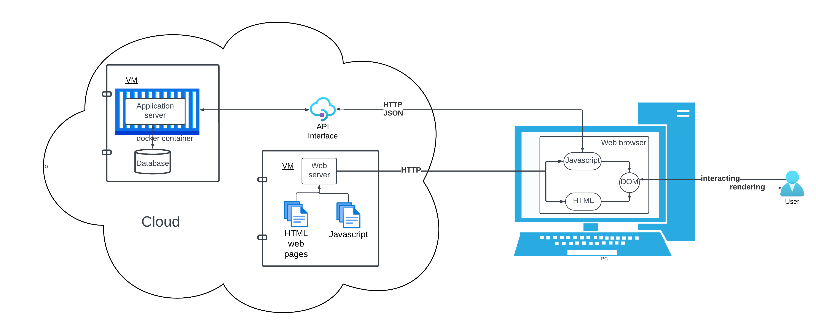
Web Application Deployment

Slide 8
Web application breakdown
Cloud components
Application server virtual machine
HTTP API interface
Database application
Embedded no-SQL database
Web server virtual machine
HTML web pages
Javascript files
User components
Browser
HTML
Javascript/jQuery code
Domain object model

Slide 9
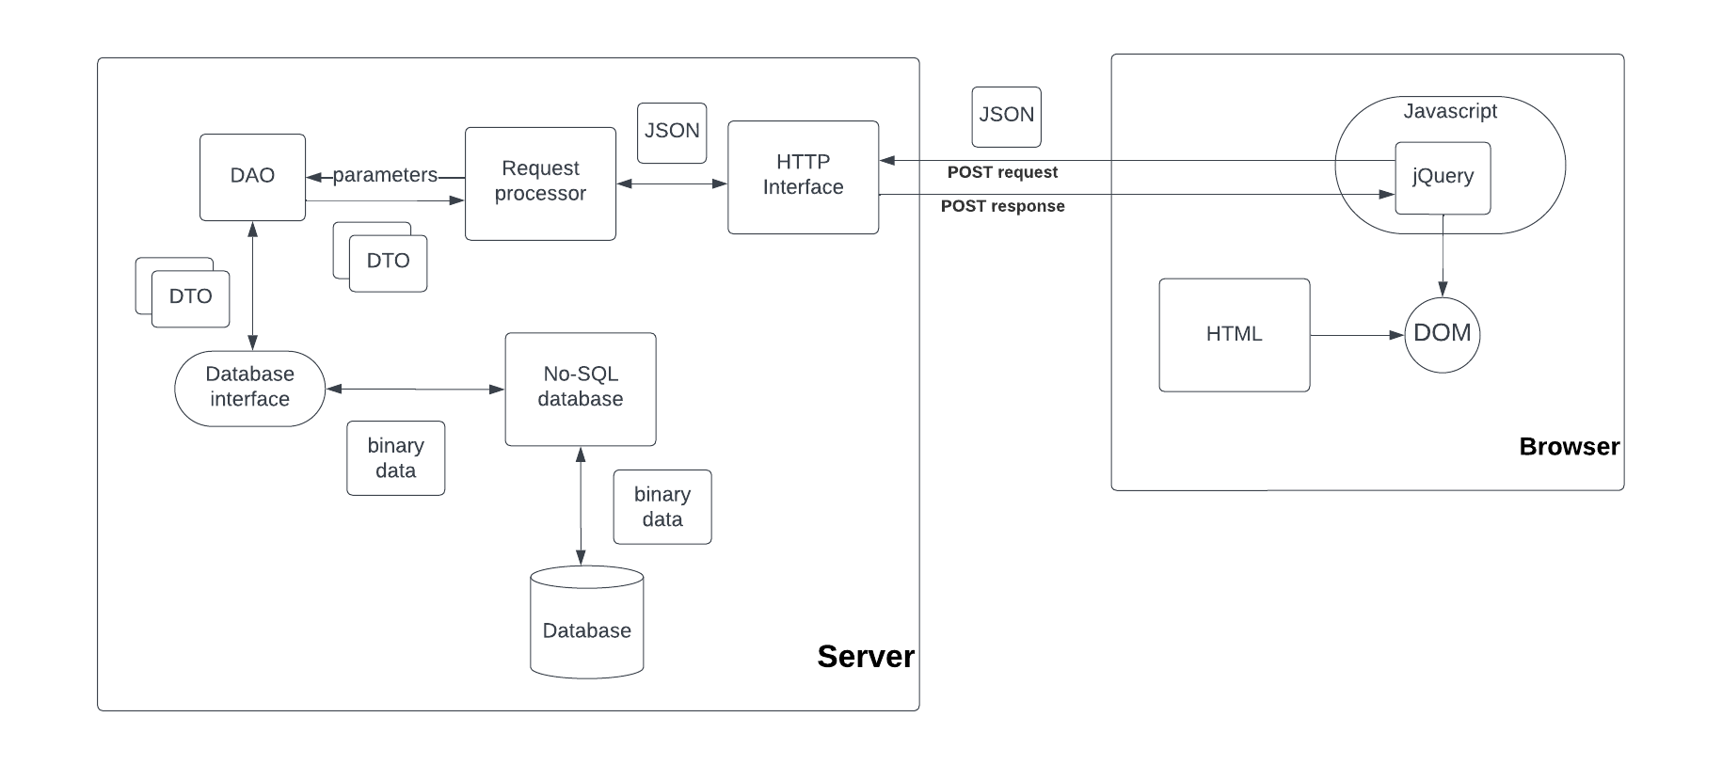
C++ Web Framework Architecture

Slide 10
Server and Client Components
Server components
HTTP interface
Receives and sends JSON POST requests and responses
Web request processor
Processes JSON application requests
Data Access Objects
Exchanges data transfer objects with database interface
Database interface
Serialize and deserialize DTOs as binary data to database interface
No-SQL database interface
Provides key indexed access to database records
Client components
HTML pages and Javascript
jQuery REST calls
DOM UI user interface

Slide 11
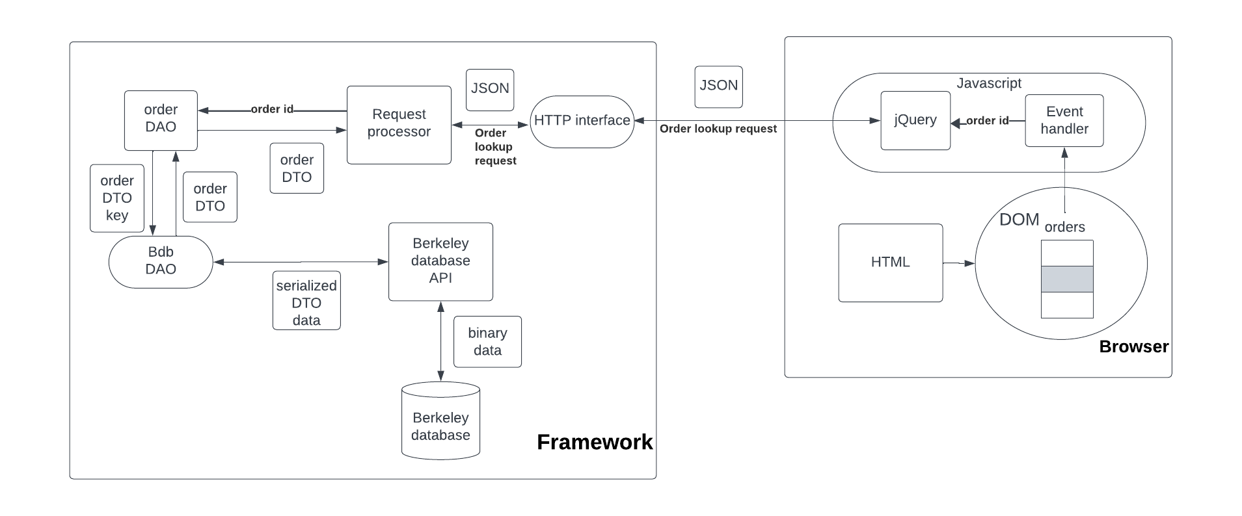
Sample application

Slide 12
Sample Application Components
Browser
Select order table row
Event handler requests order data
jQuery JSON REST call to server
Framework
HTTP JSON request received
Request processor accesses Order DAO
Order DAO sends Order DTO key to database Bdb DAO
Bdb DAO passed binary serialized DTO to Berkeley DB
Order details returned as binary data, Order DTO, then JSON to browser

Slide 13
Code walkthrough
Main program
Socket interface: Bdb_inet_socket_server/Bdb_inet_socket_client
JSON Request handler: Dconf_request_handler
Order request handler: Dconf_order_request_handler
Order lookup: Order_DAO, Order_DTO
Database interface: Bdb_DAO
Berkeley DB access: Bdb_dbp, Bdb_dbt

Slide 14
Conclusions
Framework consists of C++ classes and templates
HTTP Network interface uses TCP/IP sockets
Server receives REST JSON request packets
Requests dispatched using handler code
Handlers use DAOs and DTOs to access database
DAOs call low level Berkeley DB DAO interface
Berkeley DB DAO calls Berkeley DB C++ API

